Slide 1

By:
Alvian Wijaya
Christy Natalia Jusman
Davin Pratama Chandra

Slide 2


Slide 3
The Background and Features
Reddit X Instagram.
Provide a platform to post.
Let the community discuss it.
Use rating system such as upvote or downvote

Slide 4
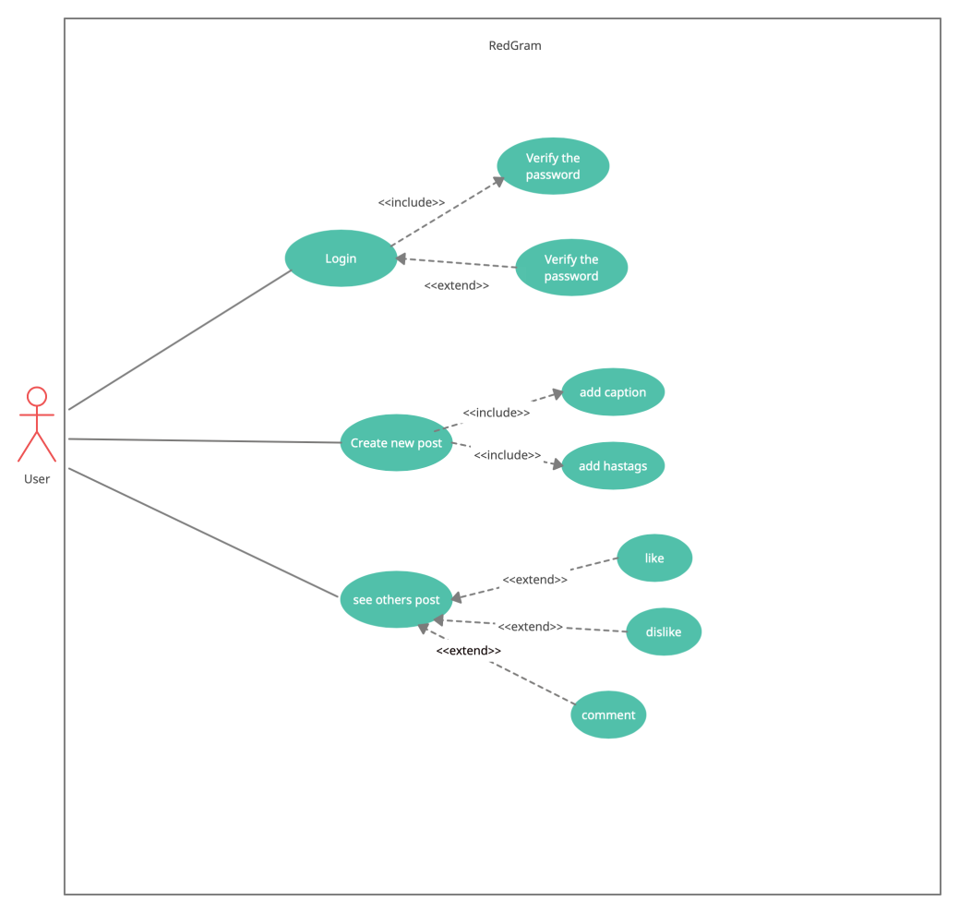
Use Case Diagram

Slide 5
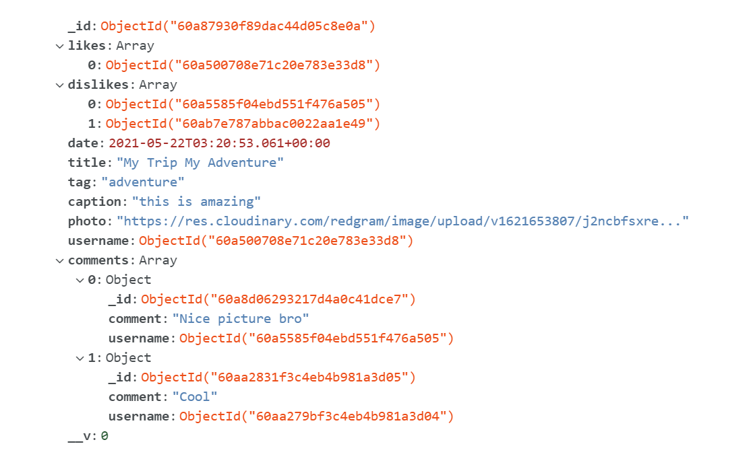
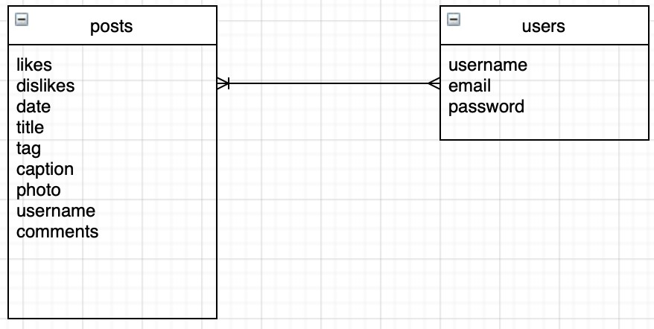
Database Models
Post model
ERD Diagram

Slide 6
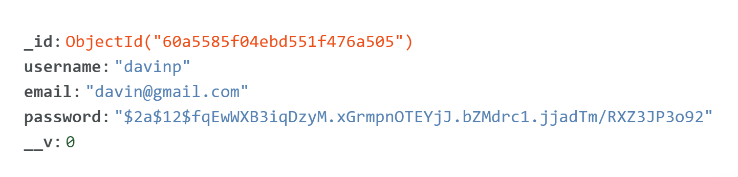
Database Models
User model

Slide 7
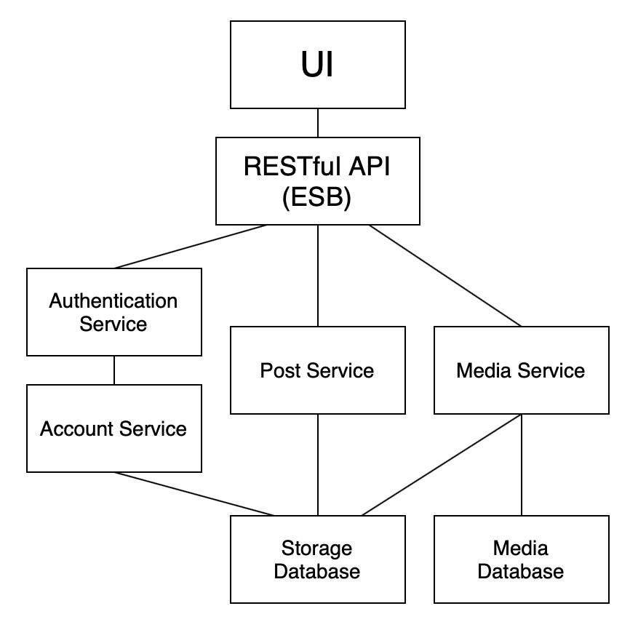
System Architecture

Slide 8
DEMO
https://redgram-wads.herokuapp.com

